Slide 1
AGENDA FOR DISCUSSION
Gene embeddings from Geneformer
In silico Perturbation
Virtual Cell challenge and Perturbation
How we approached VCC
Submitted Results and Challenges Faced

Slide 2
Gene embeddings from Geneformer
TP53:
[ 0.12, -0.45, 1.03, 0.77, ..., -0.08 ] ← 256 numbers
EGFR
[-0.34, 0.91, 0.22, -1.11, ..., 0.56 ]
BRCA1
[ 0.88, 0.14, -0.67, 0.09, ..., -0.42 ]
Geneformer Encoder
CELL 1 : [NFKB1, RELA, STAT1, STAT3, IRF1, EGR1,.............
GAPDH, ACTB, RPLP0, B2M]
CELL 2 : [FOXP3, GATA3, TBX21, RUNX1, RUNX2, SMAD3.............
GAPDH, ACTB, RPL13A, HPRT1]
CELL 3 : [HIF1A, ARNT, CREB1, ATF2, ATF3, ETS1.............
GAPDH, ACTB, PPIA, RPS18]
CELL 4 : [ESR1, AR, PPARG, NR3C1, RXRA, RARA.............
GAPDH, ACTB, RPLP0, YWHAZ]
.
.
.
.
.
.
.
CELL 5 : [SOX2, OCT4, KLF4, NANOG, MYC, STAT3.............
GAPDH, ACTB, RPL13A, TBP]
TP53:
[ 0.12, -0.45, 1.03, ..., 0.67, -0.21 ] ← 512 numbers
EGFR
[-0.34, 0.91, 0.22, ..., -0.89, 1.14 ]
BRCA1:
[ 0.88, 0.14, -0.67, ..., 0.31, -0.42 ]
TP53:
[ 0.12, -0.45, 1.03, ..., -0.18, 0.77 ] ← 768 numbers
EGFR:
[-0.34, 0.91, 0.22, ..., 1.02, -0.44 ]
BRCA1
[ 0.88, 0.14, -0.67, ..., -0.09, 0.51 ]

Slide 3
In silico Perturbation In Geneforemer
Cell 1
TP53:
[ 0.12, -0.45, 1.03, ..., -0.18, 0.77 ] ← 768 numbers
EGFR:
[-0.34, 0.91, 0.22, ..., 1.02, -0.44 ]
BRCA1
[ 0.88, 0.14, -0.67, ..., -0.09, 0.51 ]
CONTROL CELLS
Cell 1: [TP53, EGFR, BRCA1, MYC, KRAS, CDK1, BCL2, PTEN, ATM, MAPK1]
Cell 2: [EGFR, KRAS, MYC, TP53, BRCA1, MAPK1, ATM, PTEN, CDK1, BCL2]
Cell 3: [BRCA1, TP53, ATM, PTEN, BCL2, CDK1, MYC, MAPK1, EGFR, KRAS]
.
.
.
.
Cell n: [ATM, PTEN, TP53, BRCA1, EGFR, KRAS, MYC, CDK1, MAPK1, BCL2]
Geneformer Encoder
Cell 1
embeddings
Cell 2
TP53:
[ 0.47, -0.12, 0.89, ..., -0.63, 0.21 ] ← 768 numbers
EGFR:
[-0.58, 1.14, -0.09, ..., 0.76, -0.31 ]
BRCA1
[ 0.25, -0.44, -0.81, ..., 0.18, 0.64 ]
Cell 2
embeddings
Cell 3
TP53:
[ -0.21, 0.66, 0.34, ..., 0.92, -0.48 ] ← 768 numbers
EGFR:
[ 0.73, -0.18, 1.09, ..., -0.57, 0.12 ]
BRCA1
[ -0.45, 0.81, -0.22, ..., 0.67, -0.19 ]
Cell 3
embeddings

Slide 4
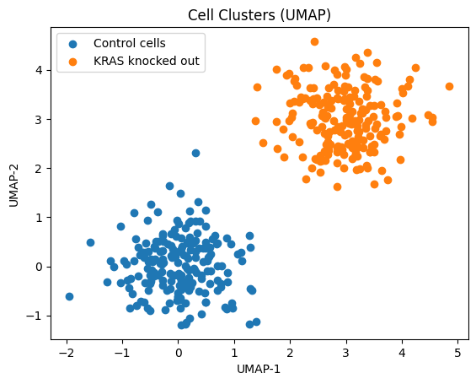

Slide 5
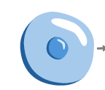
VIRTUAL CELL CHALLENGE AND PERTURBATION
TRAINING
MODEL
+ gene 1
Ground truth gene1 knocked cells
+ gene 2
Ground truth gene 2 knocked cells
+ gene 150
38 K
Control cells
MODEL
Ground truth gene 150 knocked cells
MODEL

Slide 6
Challenge in using Geneformer for VCC
* Decoder weights availablity
* Embeddings are available for only 4096/ 4095 genes
* Our target was to reconstruct for 18080 genes

Slide 7
CELL 1 : [NFKB1, RELA, STAT1, STAT3, IRF1, EGR1,.............
GAPDH, ACTB, RPLP0, B2M]
CELL 2 : [FOXP3, GATA3, TBX21, RUNX1, RUNX2, SMAD3.............
GAPDH, ACTB, RPL13A, HPRT1]
CELL 3 : [HIF1A, ARNT, CREB1, ATF2, ATF3, ETS1.............
GAPDH, ACTB, PPIA, RPS18]
CELL 4 : [ESR1, AR, PPARG, NR3C1, RXRA, RARA.............
GAPDH, ACTB, RPLP0, YWHAZ]
.
.
.
CELL 5 : [SOX2, OCT4, KLF4, NANOG, MYC, STAT3.............
GAPDH, ACTB, RPL13A, TBP]
CELL 1 : [NFKB1, RELA, STAT1, STAT3, IRF1, EGR1,.............
GAPDH, ACTB, RPLP0, B2M]
CELL 2 : [FOXP3, GATA3, TBX21, RUNX1, RUNX2, SMAD3.............
GAPDH, ACTB, RPL13A, HPRT1]
CELL 3 : [HIF1A, ARNT, CREB1, ATF2, ATF3, ETS1.............
GAPDH, ACTB, PPIA, RPS18]
CELL 4 : [ESR1, AR, PPARG, NR3C1, RXRA, RARA.............
GAPDH, ACTB, RPLP0, YWHAZ]
.
CELL 5 : [SOX2, OCT4, KLF4, NANOG, MYC, STAT3.............
GAPDH, ACTB, RPL13A, TBP]
Geneformer Encoder
Geneformer Decoder
TP53:
[ 0.12, -0.45, 1.03, ..., -0.18, 0.77 ]
EGFR:
[-0.34, 0.91, 0.22, ..., 1.02, -0.44 ]
BRCA1
[ 0.88, 0.14, -0.67, ..., -0.09, 0.51 ]
..
..
..
..
..
Gene 4096
[ 0.88, 0.14, -0.67, ..., -0.09, 0.51 ]
Geneformer Encoder

Slide 8
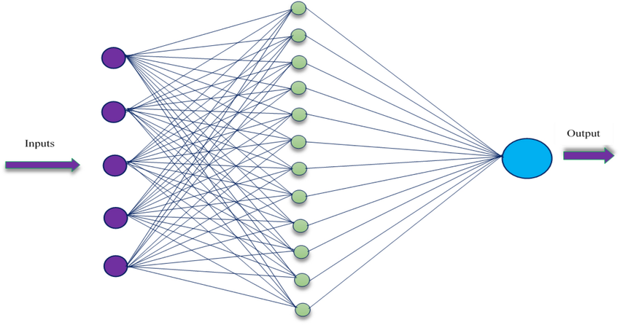
How we approached VCC
Generate emeddings for each cell in g1
Generate outcome per cell
Generate outcome per cell
Dim 18080
Rank value encodings
4096 dimension X no of cells for g1 perturbation
Remove g1
Geneformer Encoder
Generate emeddings for each cell in g2
Rank value encodings
4096 dimension X no of cells for g2 perturbation
Remove g2
Rank value encodings
4096 dimension X no of cells for g3 perturbation
Remove g3
Generate emeddings for each cell in g3
Rank value encodings
4096 dimension X no of cells for g150 perturbation
Remove g150
Generate emeddings for each cell in g150
Generate outcome per cell
Dim 18080

Slide 9
At each Cell level
Cell 1
TP53:
[ 0.12, -0.45, 1.03, ..., -0.18, 0.77 ] ← 768 numbers
EGFR:
[-0.34, 0.91, 0.22, ..., 1.02, -0.44 ]
BRCA1
[ 0.88, 0.14, -0.67, ..., -0.09, 0.51 ]
Cell 1
TP53:
Expression value
EGFR:
Expression Value
BRCA1
Expression value
Generate emeddings for each cell in g1

